Slide 1

DATA STRUCTURES
UNIT-2
Dr. NAMRATHA M
ASSOCIATE PROFESSOR
B.M.S. COLLEGE OF ENGINEERING

Slide 2
Priority Queue
Priority Queue is an extension of queue with following properties.
  Every item has a priority associated with it.
  An element with high priority is dequeued before an element with low priority.
  If two elements have the same priority, they are served according to their order in the queue.

Slide 3
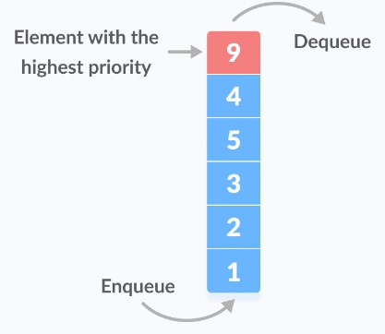
Priority Queue
In a queue, the first-in-first-out rule is implemented whereas, in a priority queue, the values are removed on the basis of priority. The element with the highest priority is removed first.

Slide 4
Types of Priority Queue
Min Priority Queue: In min priority Queue minimum number of value gets the highest priority and lowest number of element gets the highest priority.
Max Priority Queue: Max priority Queue is the opposite of min priority Queue in it maximum number value gets the highest priority and minimum number of value gets the minimum priority.

Slide 5
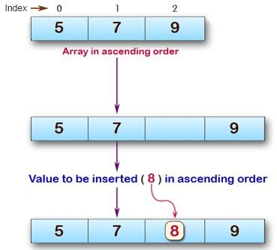
Solution

Slide 6
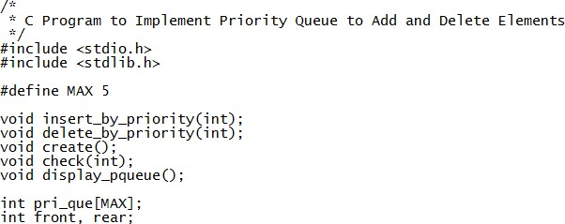
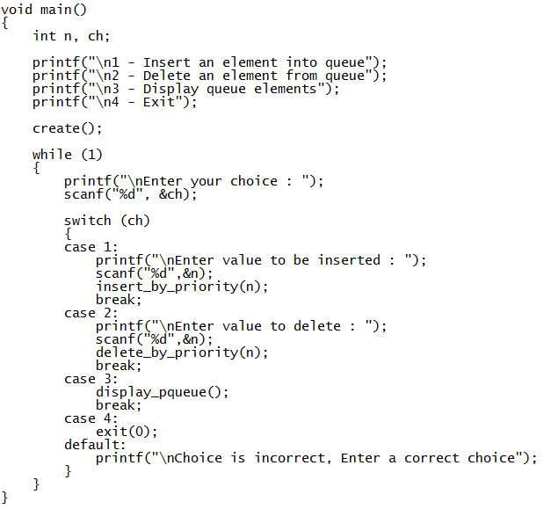
C Code

Slide 7
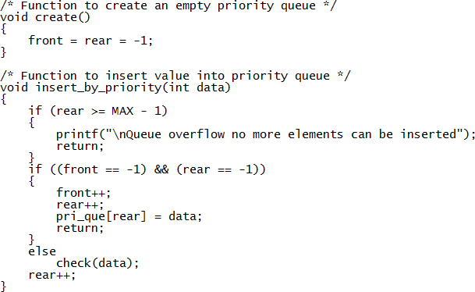
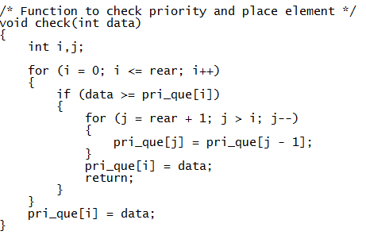
C Code

Slide 8
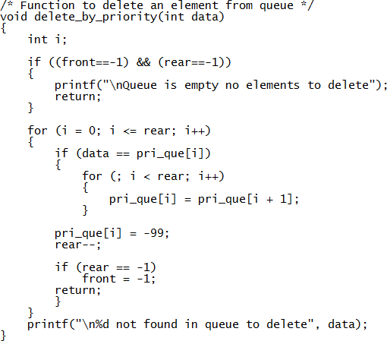
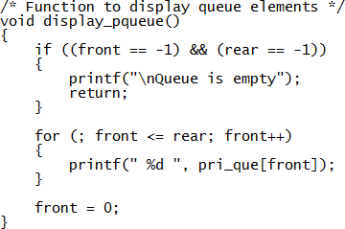
C Code

Slide 9
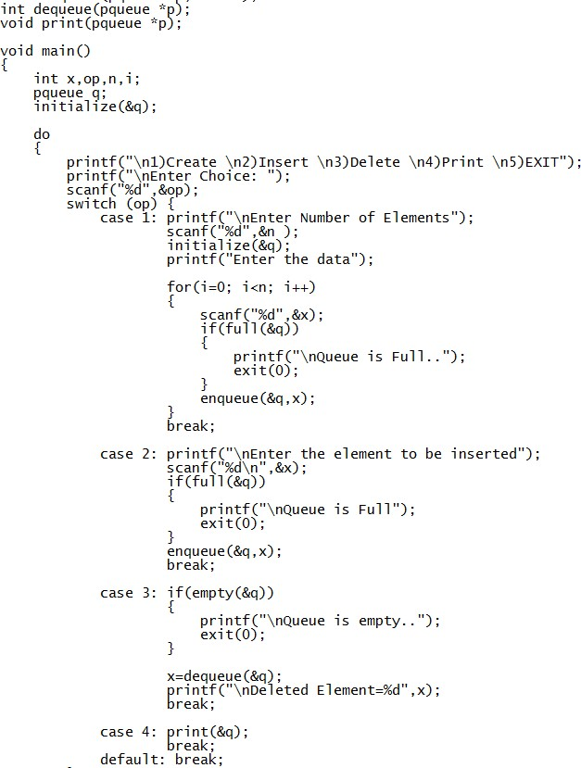
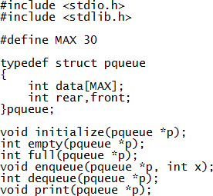
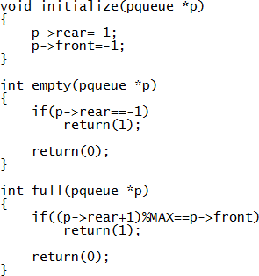

Priority Queue (Circular Q concept)

Slide 10
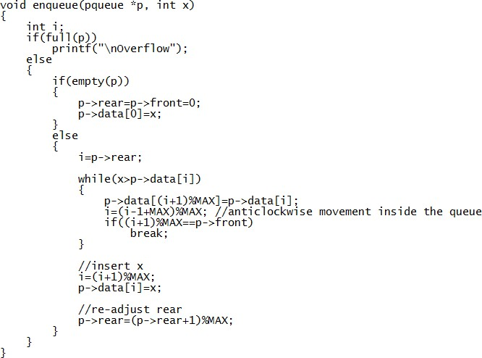

Slide 11
